Slide 1
OENG1120 Adaptive Multi-Channel Audio Processor
By: Aditya Prawira (RMIT ID: S3859061)
Email: s3859061@rmit.edu.au

Slide 2
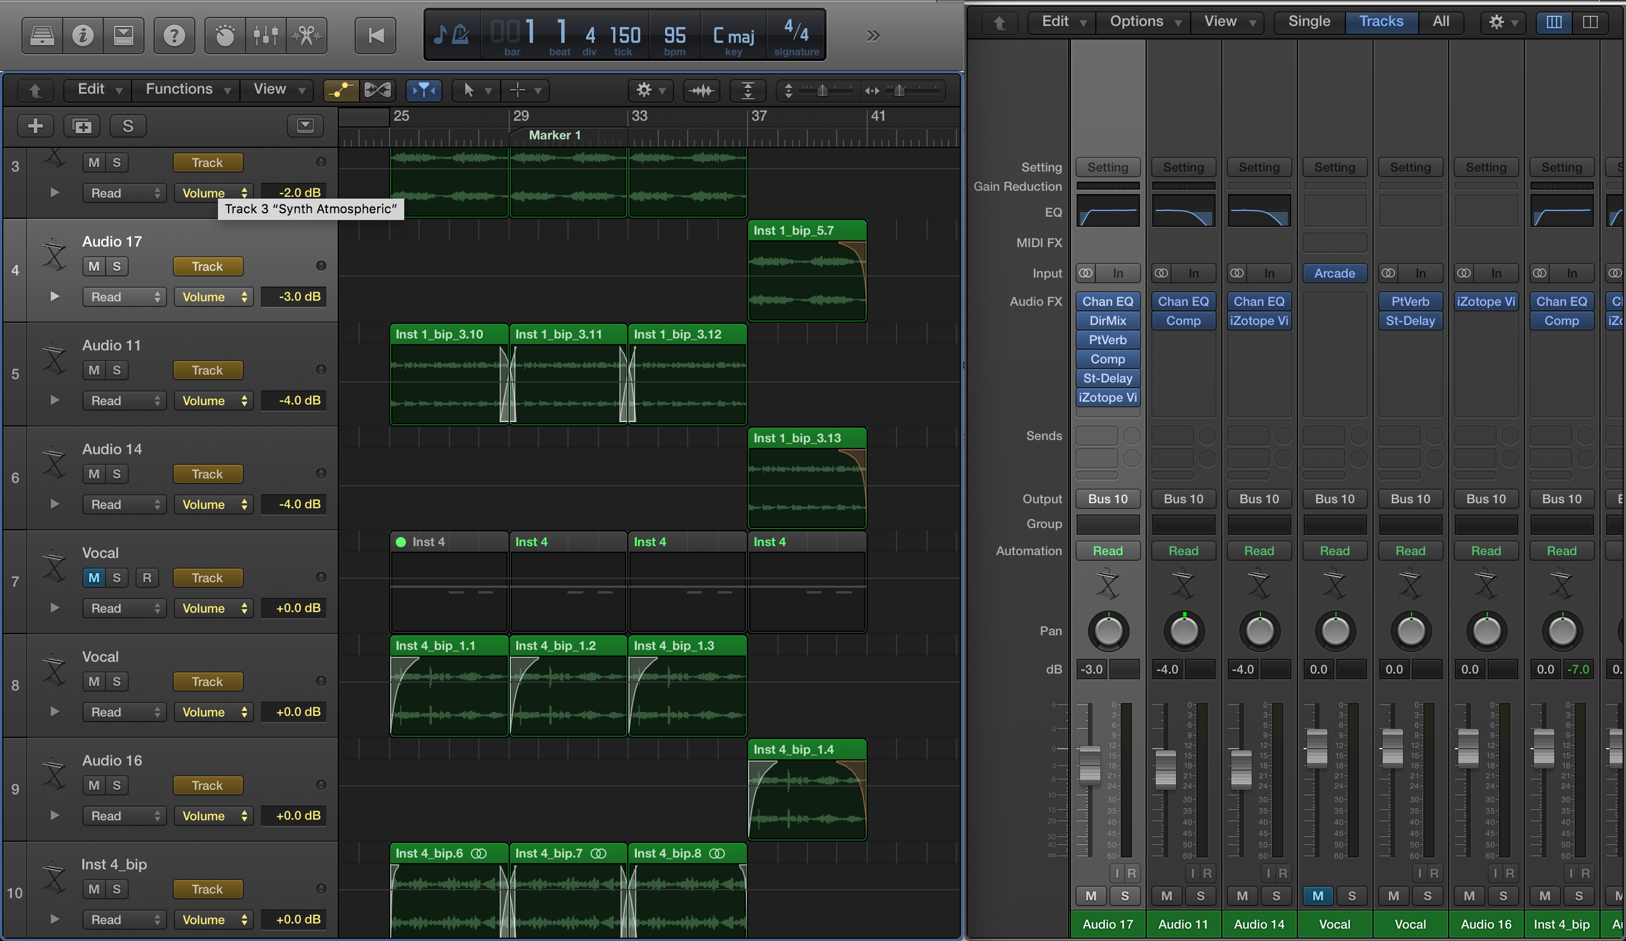
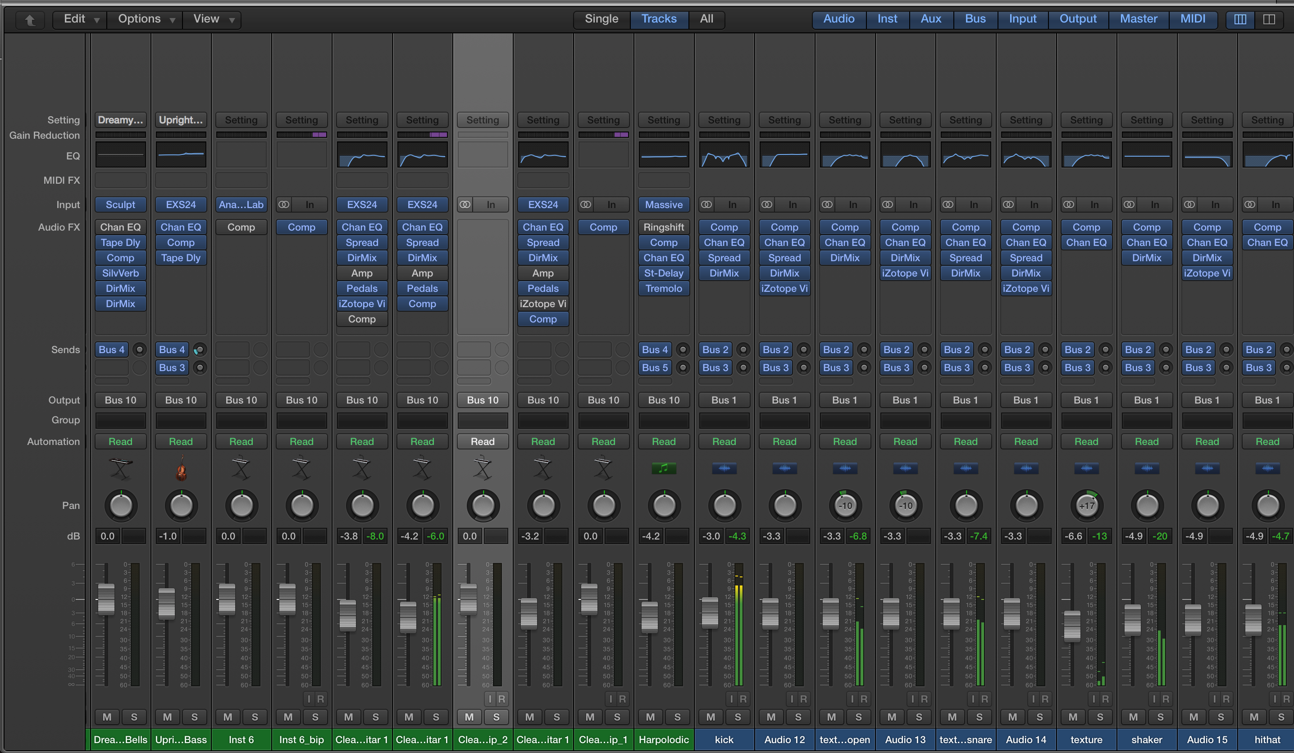
Background
Role of a music producer.
Mixing and Mastering.
“In modern music, the key to achieving a pleasing mix is an even balance of frequencies across the spectrum” (Daniel, 2019).
Figure 1: Digital Audio Workstation (DAW) Main Window (Aditya 2020 )
Figure 2: Digital Audio Workstation (DAW) Mixer Window (Aditya 2020 )
Notes:
•Mixing: Combine and adjust multiple sounds from multiple channels in a music.
•Mastering: Finalizing the mix into its final form and ready for distribution.
Music producer must have musical background, construct or compose music, engineer sounds in the music, acts as a mixing and mastering engineer.
Must able to manage the music, promote, and find your audience to get recognized
The goal of mixing is to maximize the sound quality of a of each sound layers in a music and make each balance to one another possible.
Enhances sounds to be as comfortable and consistent as possible.
- Applying highness and low pass filter and EQ to each sound layers to make them tonally balanced
- Compressor is used to manipulate the dynamic range of a sound
Reverb, delay, modulation, tremolo and all other effects/plugins are use to engineer sounds in a music.
It is an integral role in music production to maximize sound quality in a music.

Slide 3
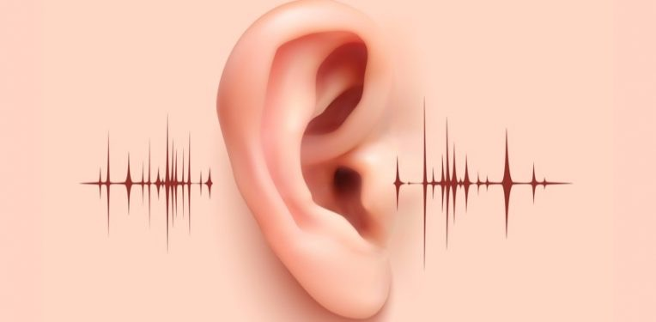
Problems
Human hearing limit (20 Hz – 20 kHz, with upper limit decreasing to 16 kHz)
Excessive time consumption on mixing leads to health issues (Psychologically and Physically)
Hiring an audio engineer can be very expensive for new artists or small band
It can cost for $22 - $45 AUD per hour (PayScale, 2020).
Notes:
Inexperience to mixing reduce music productivity, quality and time consuming.
Difficulty to identify which audio channel that cause the overall audio sounds unsatisfactory. This is a time consuming process.
Bad audio mixing cause discomfort to listener’s ear.
Excessively time spent on mixing can lead to ear fatigue.
What is ear fatigue: when ear is exposed to sounds in long duration the more nerve become agitated and tired.
Inner ear pain
Loss of hearing sensitivity that makes listener of needing more sound volume which increase sensitivity loss rate.
Loss of clarity (Sounds are “blurring”, leads to inaccurate mixing. Sounds that has been engineered, that is actually good can be sounded bad and being reengineered).
Discomfort which caused stress.
Can leads to tinnitus.

Slide 4
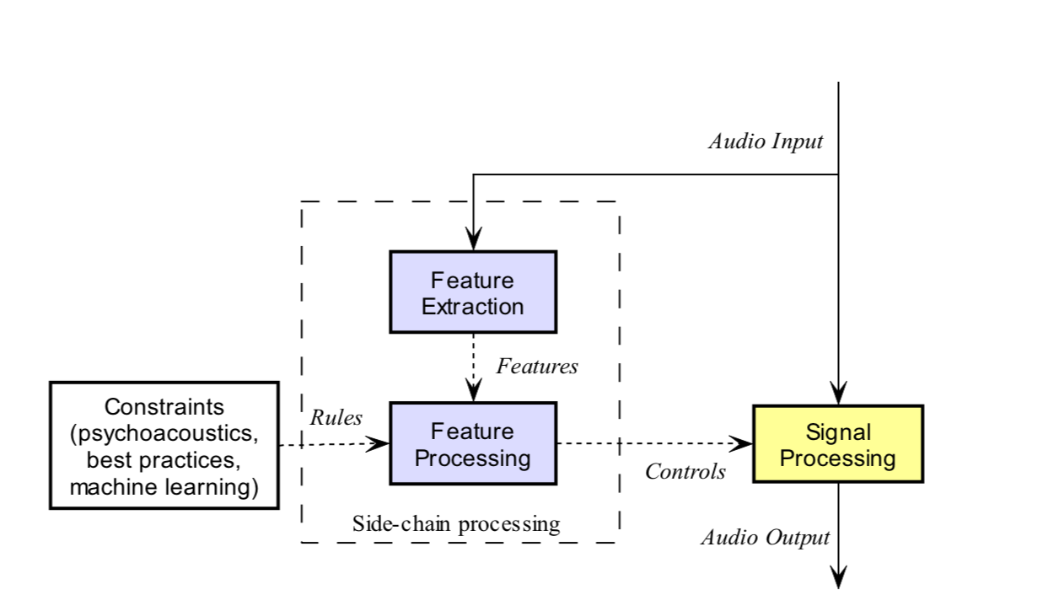
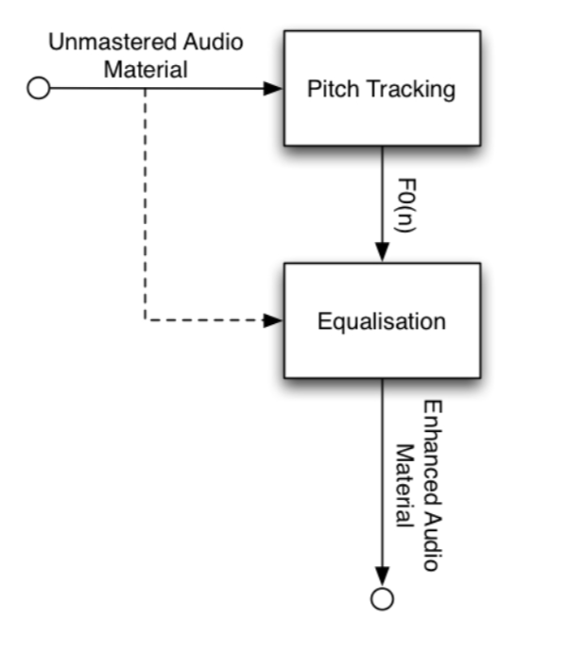
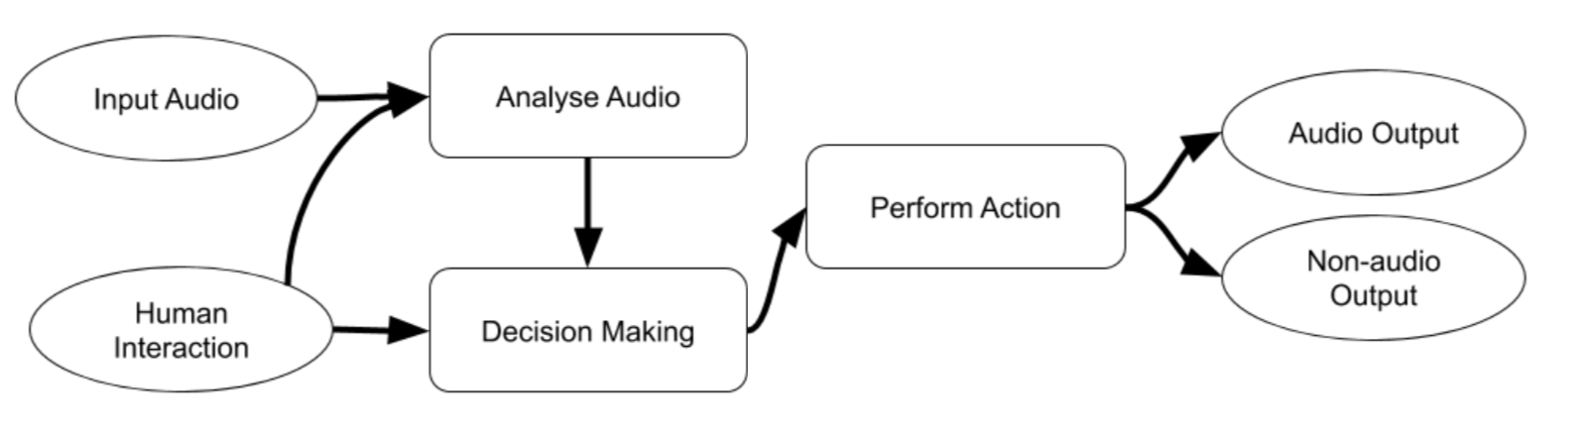
Current State of the art
Adaptive effect for single/multi audio channel
Adaptive Tonal Balance enhancement
The Current intelligent mixing system is a “black box” (Brecht, Joshua, and Ryan, 2017)
Lack of Psychoacoustic data
Figure 3: Block diagram of intelligent audio effect for single audio channel (Joshua 2011)
Figure 4: Adaptive Tonal Balance Concept’s Block Diagram (Stylianos, Konstantinos, Andreas, & Dionysios 2013)
Figure 5: Flow chart of a intelligent music production tool (David , & Mark 2019)
Notes:
Adaptive which control panning of the audio source whether depending on its frequency or sound level.
Furthermore, the ability of this automation is limited to sound volume, fade in and out of a sound, EQ playing. And, it still needs human interaction to create constrains or condition of that automation to do a specific task.
Traditional audio effect automation is restricted to a single predefined set of Digital Sound Processing Tools which limit Intelligent Mixing System.
Tonal balance enhancement is only used for mastering and to process single un-mastered audio input.
It provide an efficient pitch tracking that provide robust and efficient sample by sample computation.
It is proven that tonal balance audio output obtained more scores for majority of experienced listener compare to that audio output without tonal balance system.
Adaptive EQ that perform fundamental frequency tracking
Economically friendly and in long term will be reduce music production cost
Allows new producers or inexperience producer to improve their skills to mix and master their music
Allowing producers to innovate new ideas in producing music or sound and make their life simpler.
mix engineers or music producers experiences on mixing practices.
Current Intelligent Mixing system is a “black box”.
Require more psychoacoustics data of listeners to maximize automation/intelligent mixing criteria.
Black box : the system is highly depends on the quantity and quality of gathered data.
Different listener has different preferences to sound.

Slide 5
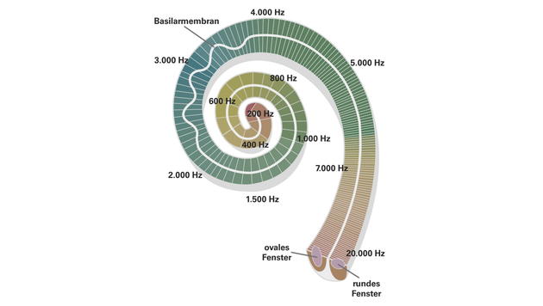
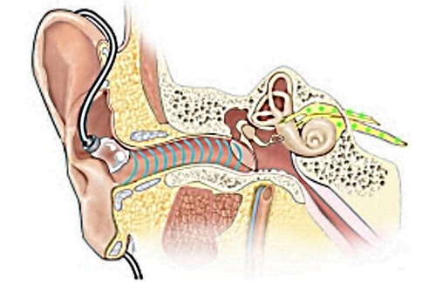
Research gaps
Adaptive Optimization system.
Adapting to sound during recording process
Does the current technology reduce occurrence of ear fatigue
Figure 6: Illustration of Psychoacoustic (Technishce Universität Dresden, 2018)
Figure 7: Illustration sound travelling to human’s ear (ProSoundWeb, 2018)
Notes:
How about and adaptive EQ that can perform audio signal processing by removing all unnecessary frequency from an audio input and keep adapting to optimize the audio input regardless to any plugins or manipulators applied to that sound since the current technology is still static.
Can this technology to be developed to create an adaptive recording technology that mixed sound from “in process” recording. (For example mixed the sound while recording a guitar playing)
The technology reduce the probability of ear fatigue that affect music production
Identify Error through audio signal processing.
Can the system be more efficiency so any task wont be repetitive.
Initializing adaptive audio processor based on music genre through selection system. Implementing music genre on the system. No changes need to be made only genre selection since the system will be adapt to any sound input it takes and produce produce satisfactory sound quality of the music based on specific genre chosen as an input.

Slide 6
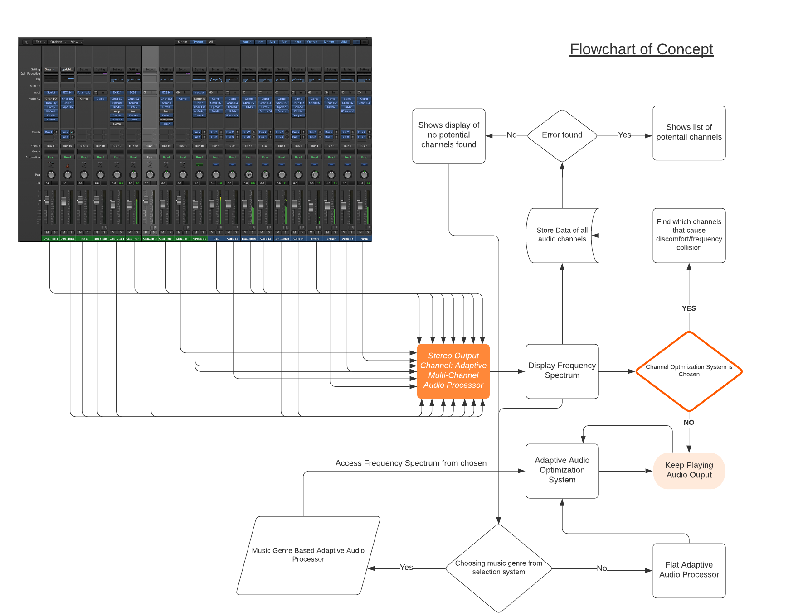
Research Gaps
Error Identification (further details of proposed concept are provided in Figure 8).
How many percent of average normal time spent on mixing can be reduced?
Utilize music genre, as preference, on adaptive audio processor
Figure 8: Potential Concept by integrating current technology (Aditya, 2020)

Slide 7



Expected Outcomes
Improve productivity rate and economic advantage
Allows for Healthy mixing
Improve mixing accuracy (quality control).
Reduce workload or human interaction
Enhance recording/producing workflow
Worthy asset for both parties.
Notes:
New software that can be profitable and beneficial for both organization and consumer in the music industry.

Slide 8
References
Clason, D., 2017. Hearing Loss And Listening Fatigue. [online] Healthy Hearing. Available at: <https://www.healthyhearing.com/report/52807 Hearing loss-and-listening-fatigue> [Accessed 8 August 2020].
Dixon, D., 2019. Psychoacoustics: How Perception Influences Music Production. [online] iZotope. Availabl at: <https://www.izotope.com/en/learn/psychoacoustics-how-perception-influences-music- production.html> [Accessed 8 August 2020].
Hcaudiology. 2020. Tinnitus. [online] Available at: <http://www.hcaudiology.net.au/tinnitus/#:~:text=Tinnitus%20is%20a%20physical%20conditio n,or%20ringing%20like%20a%20bell'.> [Accessed 7 August 2020].
H., J., 2020. Ear Fatigue Symptoms When Mixing With Headphones & Monitors | LN. [online] LedgerNote. Available at: <https://ledgernote.com/columns/mixing-mastering/ear-fatigue-symptoms/> [Accessed 7 August 2020].
Man, B., Stables, R. and Reiss, J., 2017. Ten Years of Automatic Mixing. Proceedings of the 3rd Workshop on Intelligent Music Production,.
Mastering the Mix. 2015. Creating Space In Your Mix. [online] Available at: <https://www.masteringthemix.com/blogs/learn/48456965- creating-space-in-your- mix#:~:text=Try%20and%20play%20around%20with,to%20give%20your%20mix%20depth.&t ext=Panning%20is%20a%20useful%20tool,focus%20on%20high%20energy%20elements.&text =You%20can%20use%20reverb%20and,without%20affecting%20your%20mono%20signal.> [Accessed 7 August 2020].
Mimilakis, S., Drossos, K., Floros, A. and Katerelos, D., 2013. Automated Tonal Balance Enhancement for Audio Mastering Applications. AES 134th Convention,.
Moffat, D. and Sandler, M., 2019. Approaches in Intelligent Music Production. Arts, 8(4), p.125.
Payscale. 2020. Sound Engineer Hourly Pay In Australia | Payscale. [online] Available at: <https://www.payscale.com/research/AU/Job=Sound_Engineer/Salary> [Accessed 7 August 2020].
Reiss, J., 2011. Intelligent systems for mixing multichannel audio. 2011 17th International Conference on Digital Signal Processing (DSP),.
Rosenkranz, R., 2018. Psychoacoustics. [online] TU Dresden. Available at: <https://tu- dresden.de/ing/elektrotechnik/ias/aha/forschung/akustik/psychoakustik?set_language=en> [Accessed 8 August 2020].
Stamper, A., 2018. In The Studio: Beware Of Ear Fatigue - Prosoundweb. [online] ProSoundWeb. Available at: <https://www.prosoundweb.com/in- the-studio-beware-of-ear-fatigue/> [Accessed 9 August 2020].

